Slide 1

Trips & Travel.com
Decision-3
Data Science Rakamin Batch 16

Slide 2
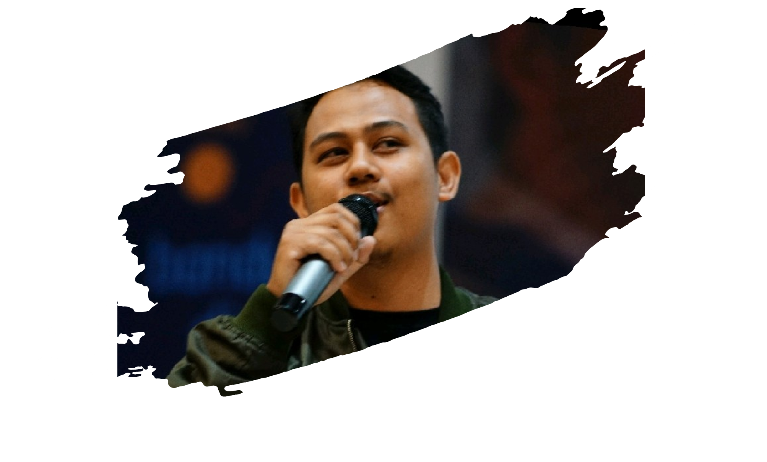




Our Team
Hermawan Sulistio
Int. Data Analyst
Selly Anggraini
Int. Data Analyst
Albertus Vincent
Int. Data Science
& Team Leader
Ade Rochmat H
Int. Data Analyst
M. Reza Habibi
Decision-3
Int. Data Science

Slide 3


1
Project Background
Content
2
Data Preparation
3
Modeling
4
Bussines Insight

Slide 4
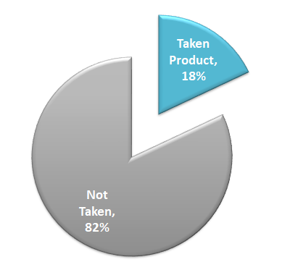

Project Background
Branding Tools Your audience relate and absorb information on different sensory levels. We know visual stories are amplified with the right words. Sometimes it's easier to go old school, our copywriters prefer a good ball.
Branding Tools Your audience relate and absorb information on different sensory levels. We know visual stories are amplified with the right words. Sometimes it's easier to go old school, our copywriters prefer a good ball.
Branding Tools Your audience relate and absorb information on different sensory levels. We know visual stories are amplified with the right words. Sometimes it's
Trips & Travel.com
is a company that provides holiday packages and want to launch new product : Wellness Tourism Package
01
4.888 customer contacted randomly
02
only 18% of the customers purchased the packages

Slide 5
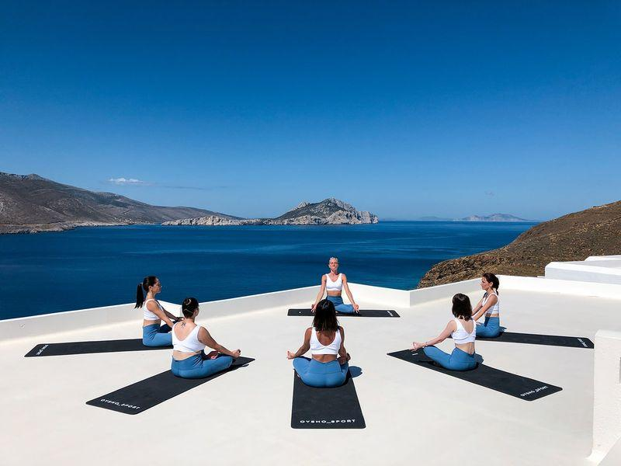


Wellness Tourism Package
Unlimited Yoga, Meditation
Unlimited Sightsseeing Experience
Unlimited Massage, Spa
“Holiday that brings about an improvement in your physical and or mental health”

Slide 6
Problem Statement
Previous customers were contacted randomly, too many unpotential customers contacted
Marketing cost is too high but only resulting 18% closing customers
Goals
Reducing Marketing Cost
Create a prediction system to cut off customers which likely won’t buy the product
Analyze ideal customer criteria based on previous sales data
Objectives

Slide 7




Customer Profile
Feature Pitching
Target
Business Metric
Age
CityTier
Occupation
Gender
PreferedPropretyStar
MaritalStatus
Passport
OwnCar
Designation
MonthlyIncome
NumberofPersonVisiting
NumberofChildren
NumberofTrips
TypeOfContact
DurationofPicth
NumberofFollowup
ProductPitched
PitchSatisfationScore
ProdTaken
Product Taken Rate
Cost Optimization
Dataset

Slide 8
Data Preparation
01
02
03
04
05
Missing Value
Outlier
Feature Encoding
Feature Engineering
Split Data
Handle missing value numerical data with MEDIAN, and
categorical data with MODE
Keep outlier value
Label Encoding : Occupation, ProductPitched, Designation
One-hot Encoding :
TypeofContact, Gender, MaritalStatus
On MaritalStatus, Unmarried and Divorced combined into Single
Ratio 80% train set,
20% test set

Slide 9
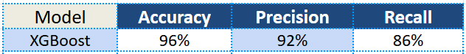
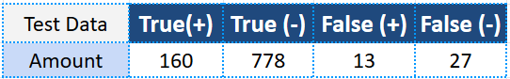
Modeling
Accuracy : Total prediction
Precision : False (+) prediction
Recall : False (-) prediction
Test Data Simulation (978 Data)

Slide 10
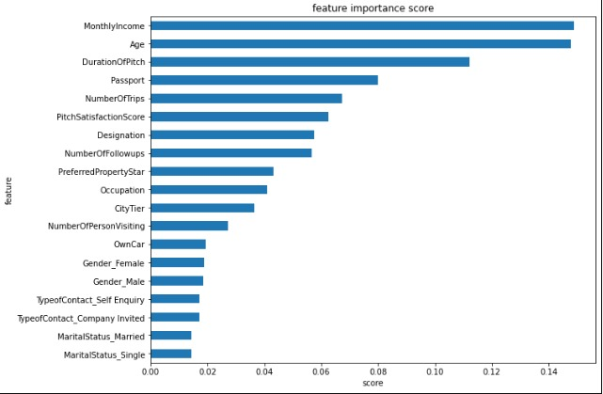
Insight

Slide 11
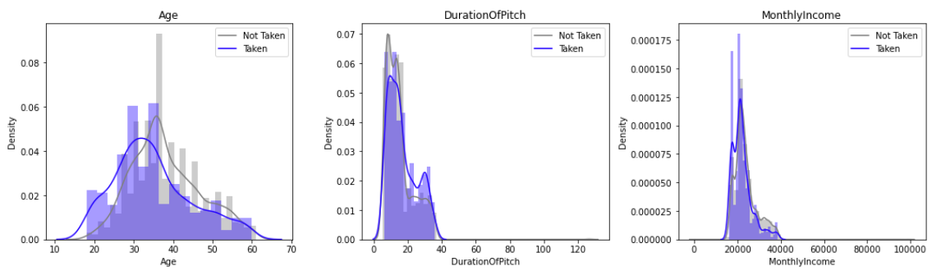
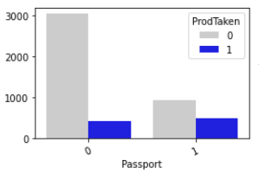
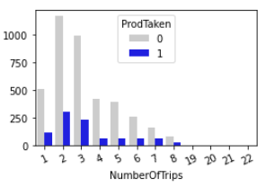
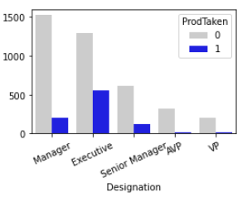

Slide 12



Ideal Customer
around $15.000 - $25.000
01
Monthly Income
around 30-35 years old
Age Range
02
Own a Passport
Passport
03
Executive
Designation
04

Slide 13

Ideal Pitching
4 - 5 minutes
01
Call duration
3 - 5 times
Number of calls
02
15 - 20 minutes
Total Duration
03
04

Slide 14
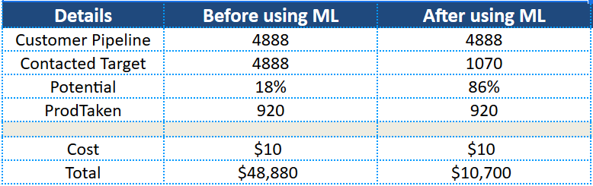
Cost Simulation
*With assumption the marketing cost is $10 per customer

Slide 15
Business Strategy Recommendation
Cost optimization
Apply Digital
Marketing Strategy
04
03
Improving TeleMarketing Technique
02
Prospect priority / ideal customers first
01

Slide 16
Thank You !
Decision-3
www.tripsandtravel.com

